Slide 1

Scaling the Dynamic Video Calling Application
Lewis Raeburn

Slide 2
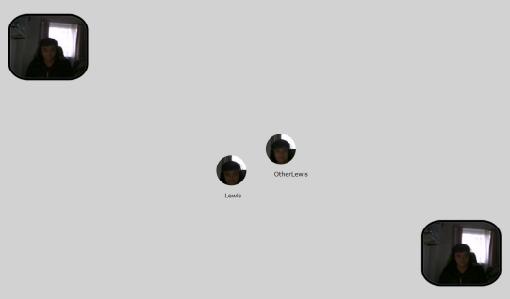
Last Year’s Work (MInf Part 1)
Implemented a WebRTC API in Links
Used the API and MVU framework to implement a (buggy) dynamic video calling application
Only 8 users can be in a video call at once before the application becomes unusable
Performance of application became worse as more users video called

Slide 3
Scaling the Application (MInf Part 2)
Application should have same, if not better, functionality but more users able to video call at once
Application should not become unusable under any circumstances
Connection errors / application crashing bugs should not be present

Slide 4
Approach
Test application under different circumstances with varying parameters (e.g. on a single computer vs on multiple computers, lower FPS, lower resolution, clustered video calls)
Identify the parameters and circumstances in which the application performed / scaled better and maximize use of these parameters where possible (e.g. lower FPS / resolution of users who aren’t talking)
Limit number of users who can be in a single video call at once
Also, measure CPU usage, message input / output rate, and message processing time of server processes as application runs (with automated version of application)
Optimize exchange of messages such that the number of messages sent to the server is minimized

Slide 5
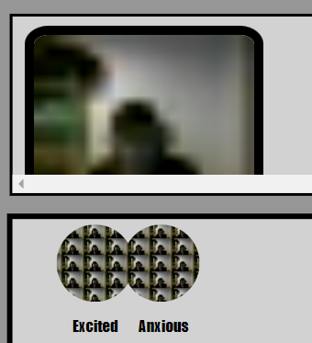
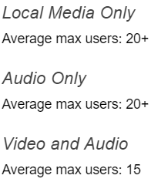
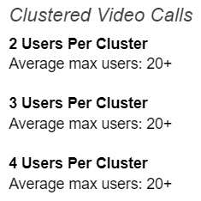
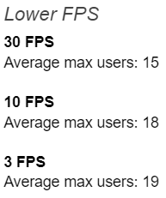
Progress So Far
Fixed all bugs identified so far (e.g. movement bugs, connection errors, timing errors)
Completed all single computer tests and most multiple computer tests
Implemented an automated version of the application that moves users into each other’s vicinity – useful for simulating proper interactions in the application (e.g. multiple users moving at once)

Slide 6
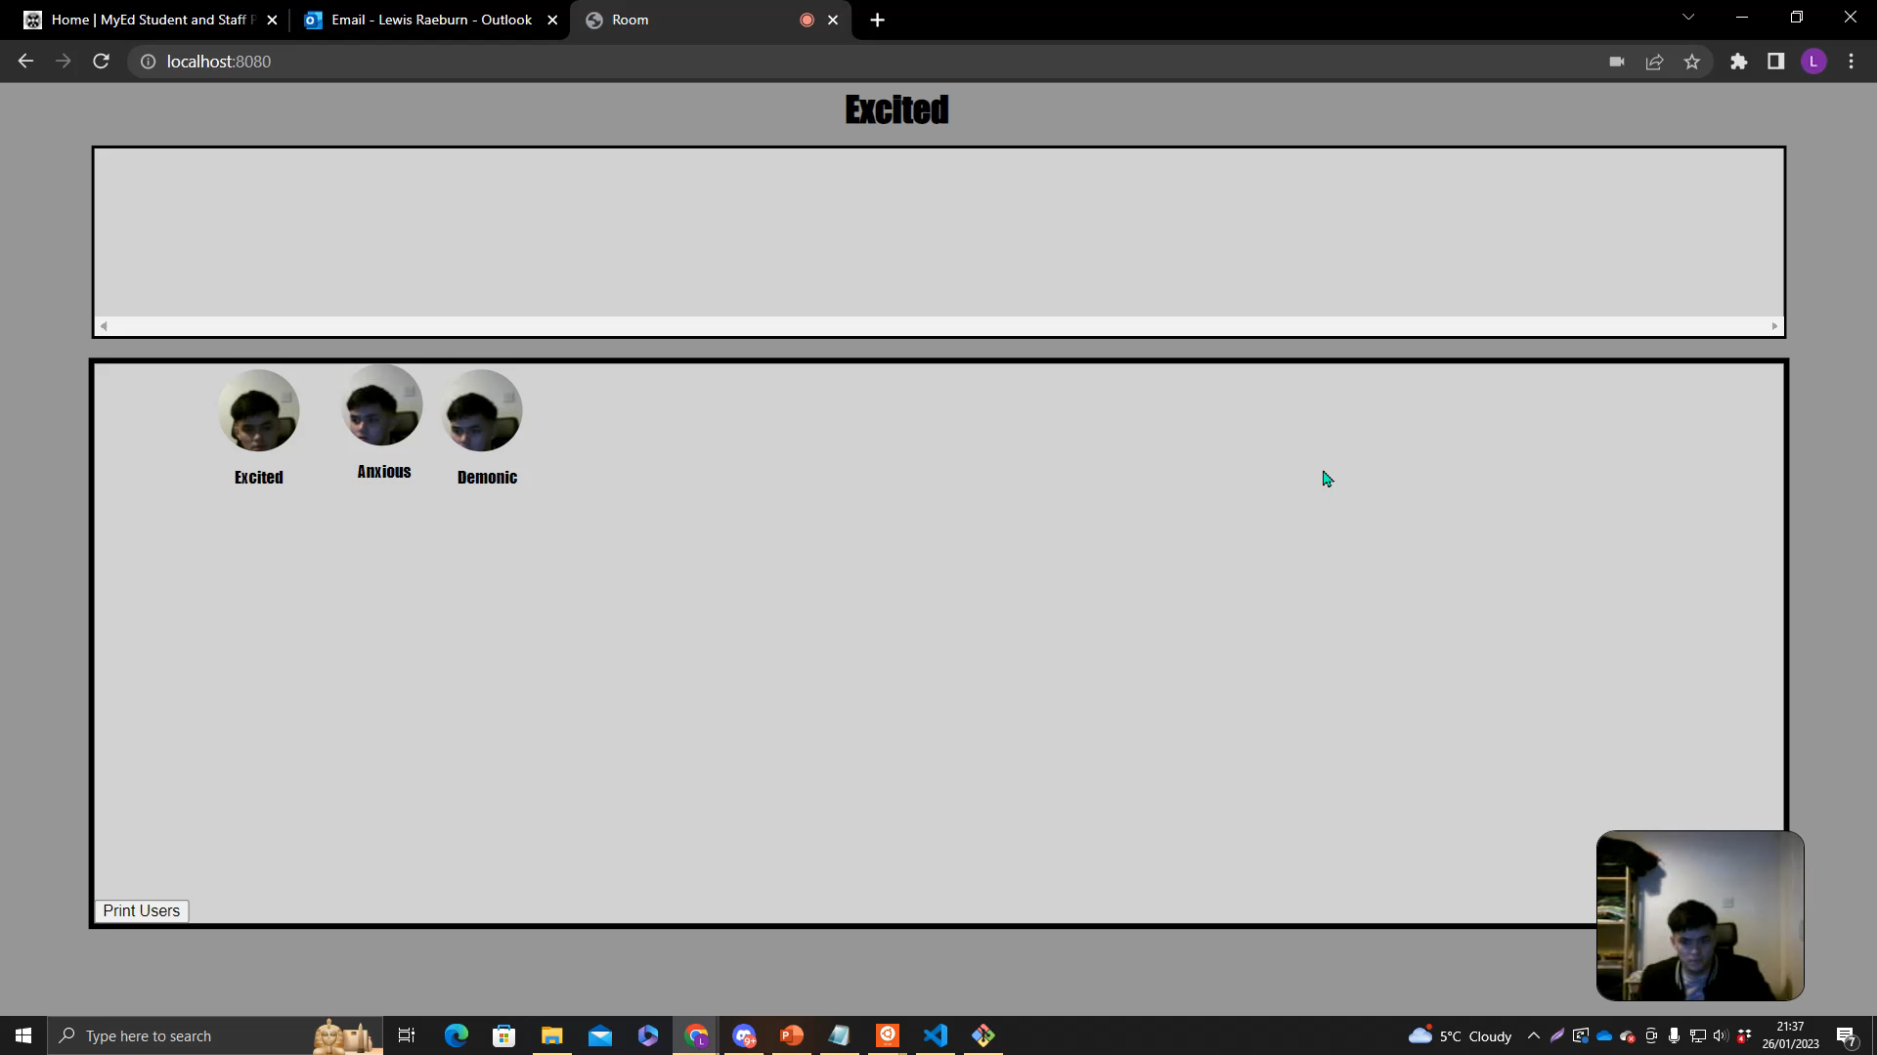

Slide 7
Next Steps
Fix a newly discovered bug where some video streams don’t appear when application is under stress
Complete last few scalability tests (lowered resolution)
Design and implement new version of application that takes advantage of lower fps, lower resolution, and clustered video calls where possible (e.g. lower fps / resolution when user isn’t active / talking, limit number of users in a single video call)
Test new version of application and compare it to original version from last year
Write dissertation…

